Slide 1
Full C# by Fakhr
Zero to hero

Slide 2
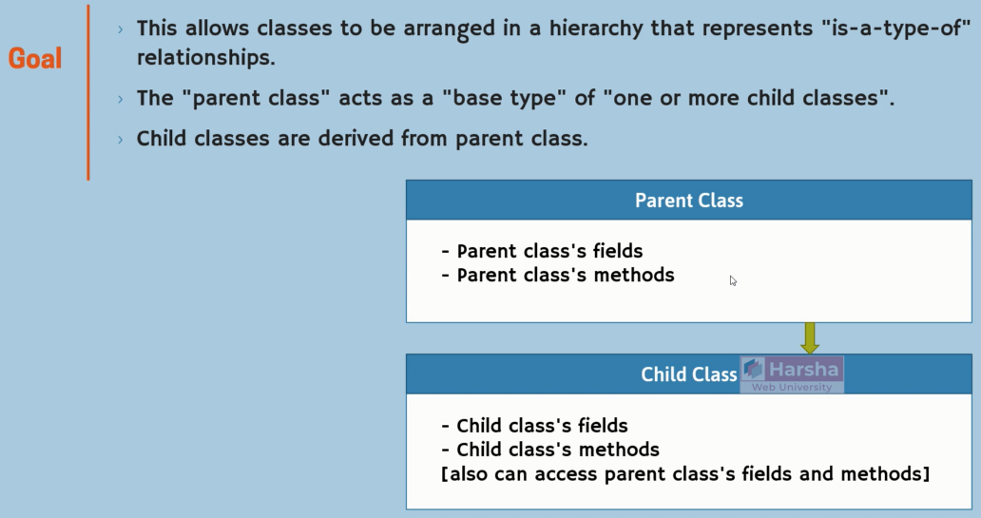
OOP – creating a class – inheritance

Slide 3
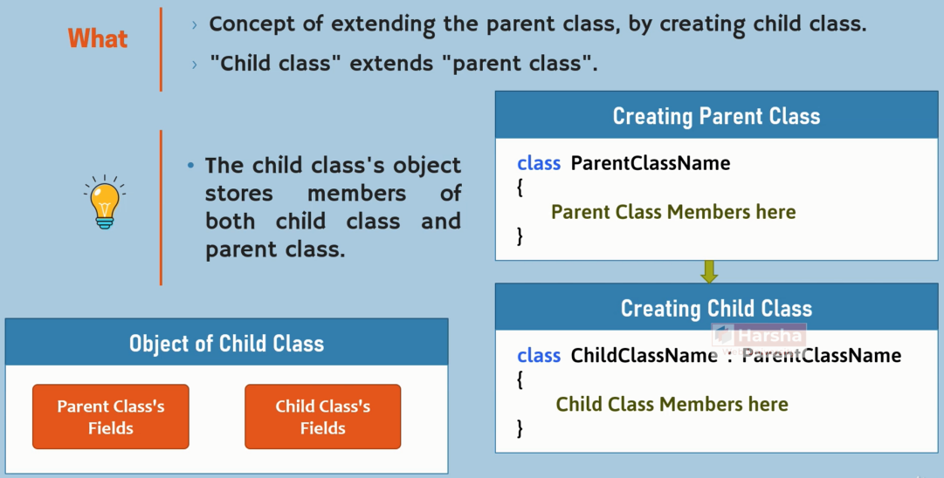
OOP – creating a class – inheritance

Slide 4
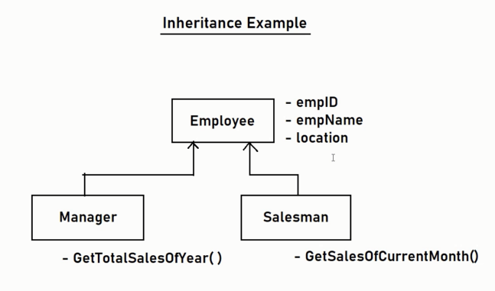
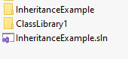
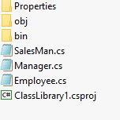
OOP – creating a class – inheritance

Slide 5
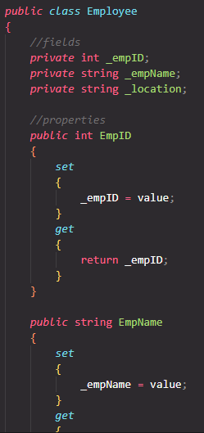
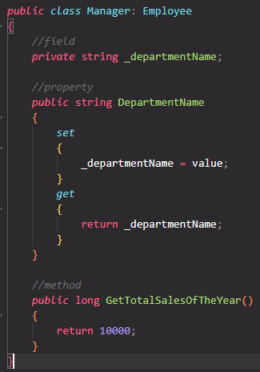
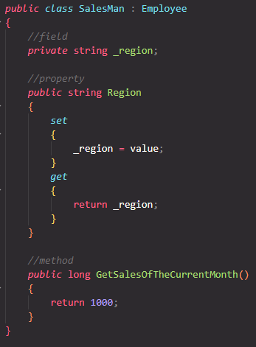
OOP – creating a class – inheritance

Slide 6
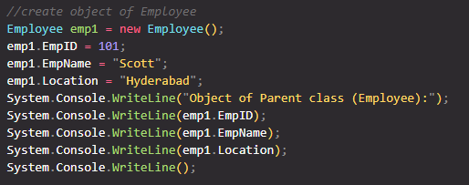
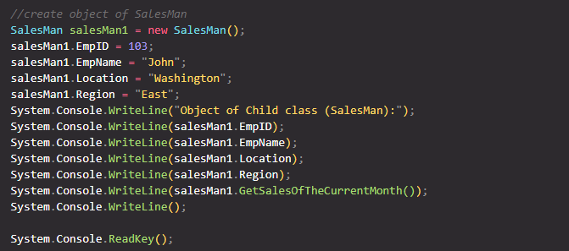
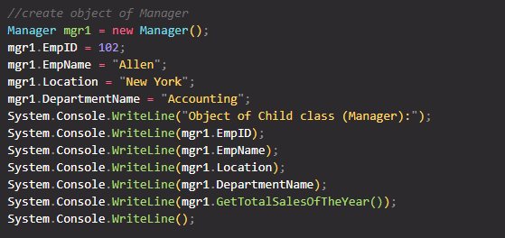
OOP – creating a class – inheritance

Slide 7
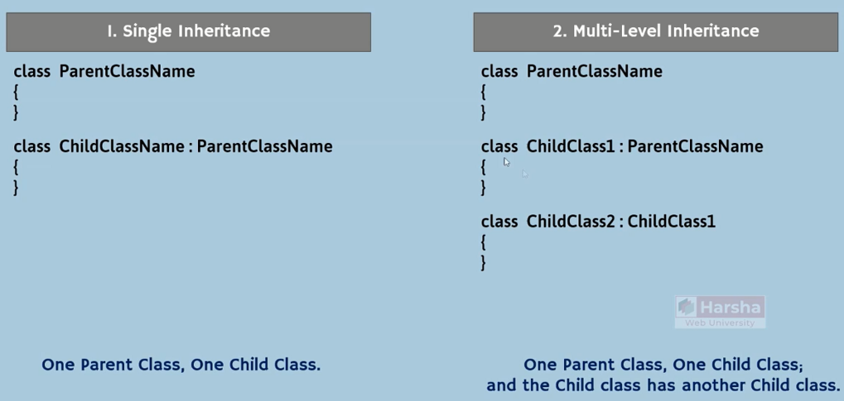
OOP – creating a class – inheritance

Slide 8
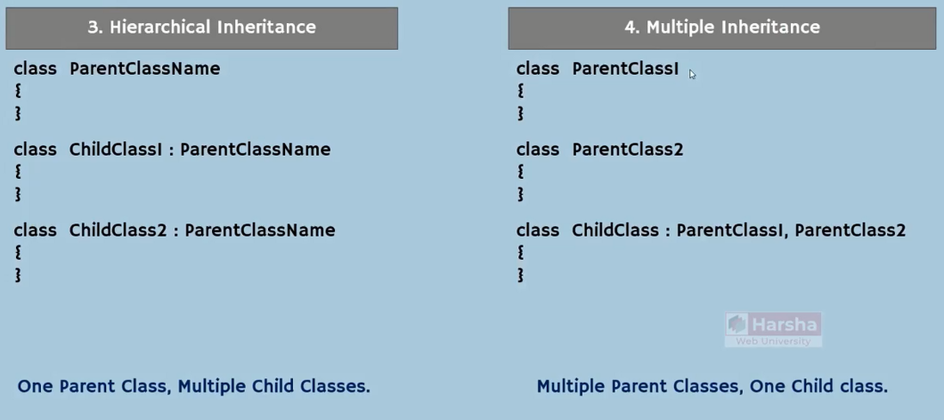
OOP – creating a class – inheritance

Slide 9
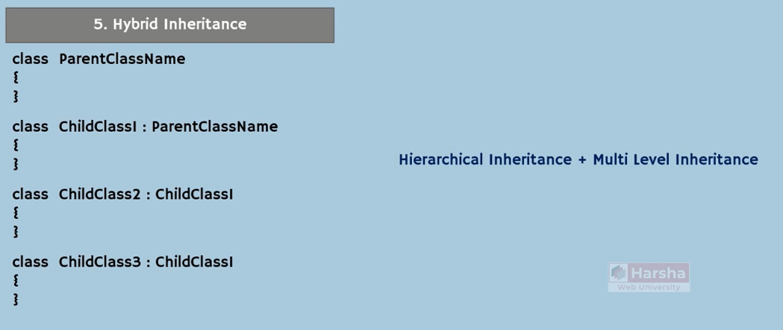
OOP – creating a class – inheritance

Slide 10
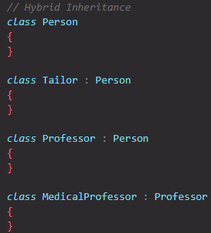
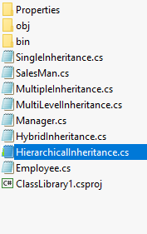
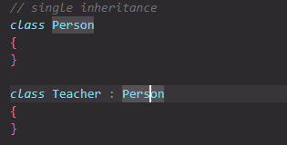
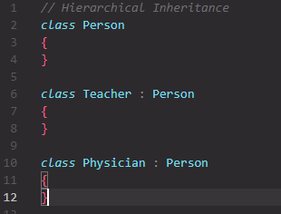
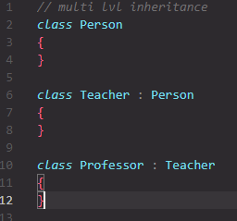
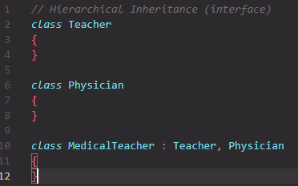
OOP – creating a class – inheritance

Slide 11
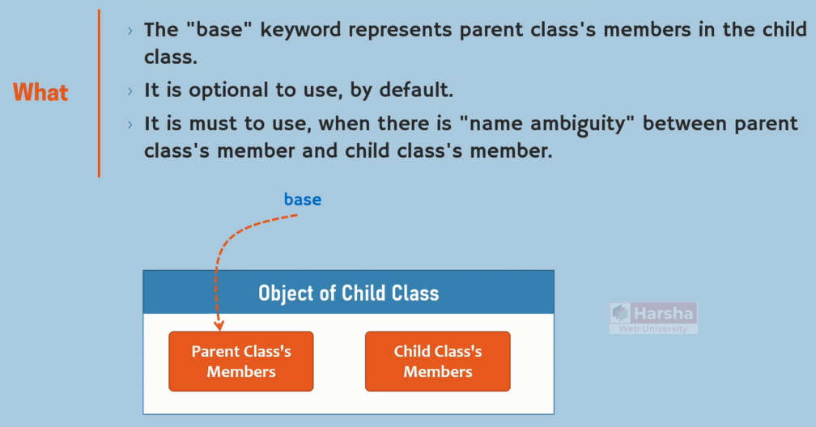
OOP – creating a class – inheritance - base

Slide 12
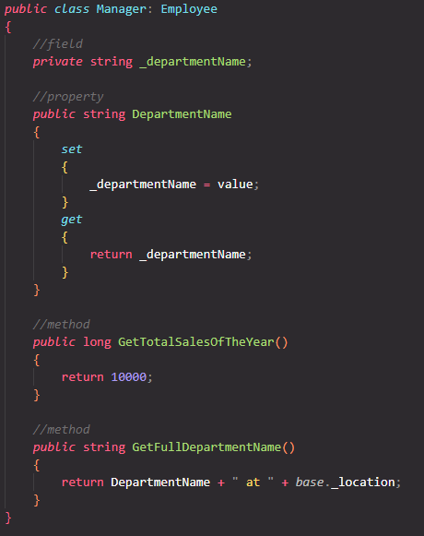
OOP – creating a class – inheritance - base

Slide 13
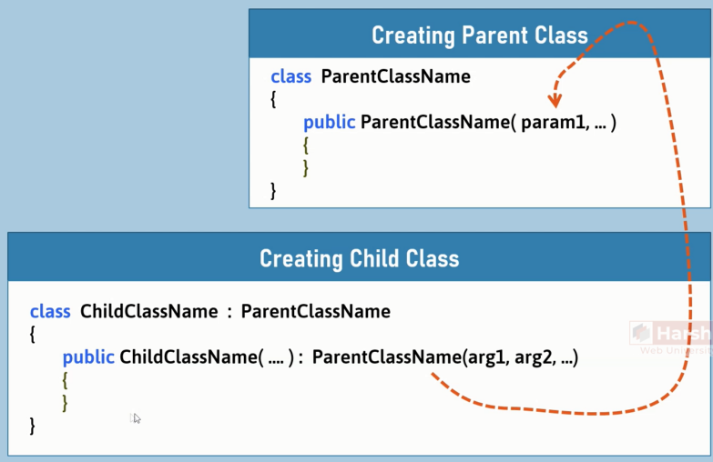
OOP – creating a class – inheritance

Slide 14
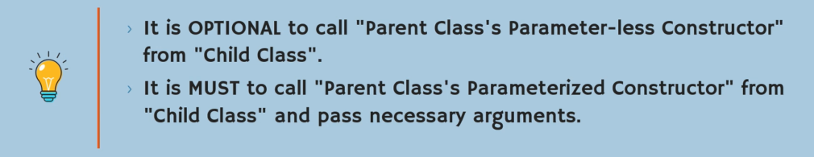
OOP – creating a class – inheritance

Slide 15
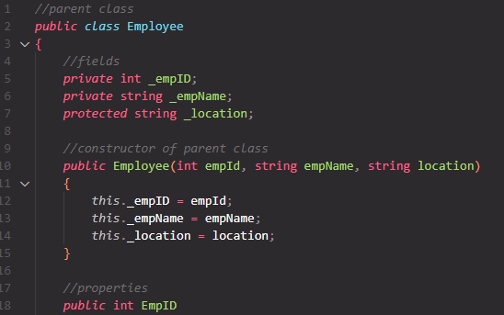
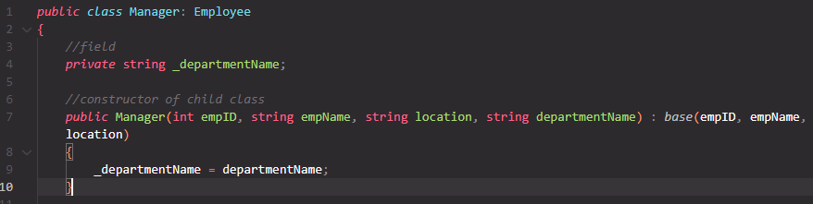
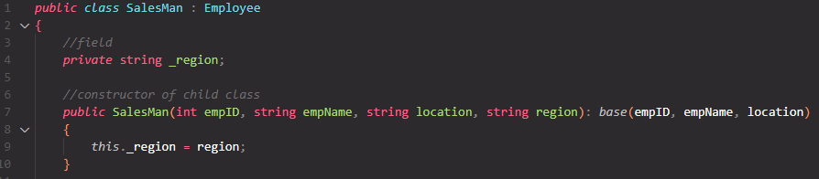
OOP – creating a class – inheritance

Slide 16
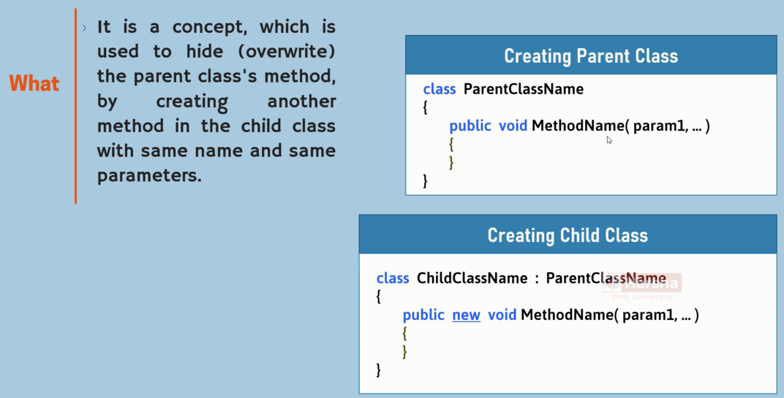
OOP – creating a class – inheritance- overwrite

Slide 17
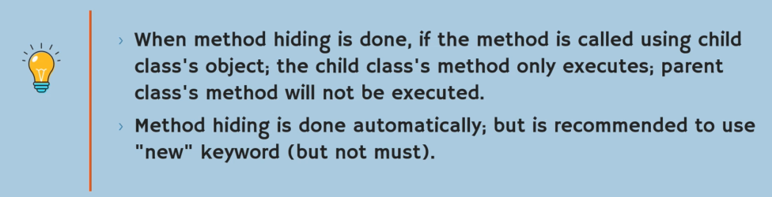
OOP – creating a class – inheritance- overwrite

Slide 18
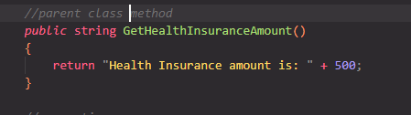
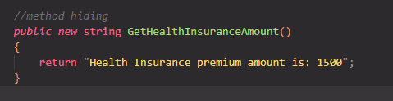
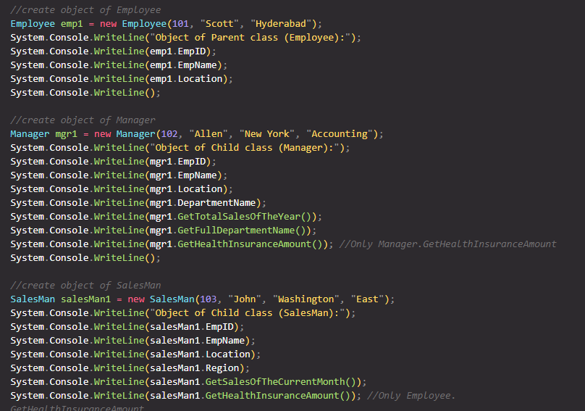
OOP – creating a class – inheritance- overwrite

Slide 19
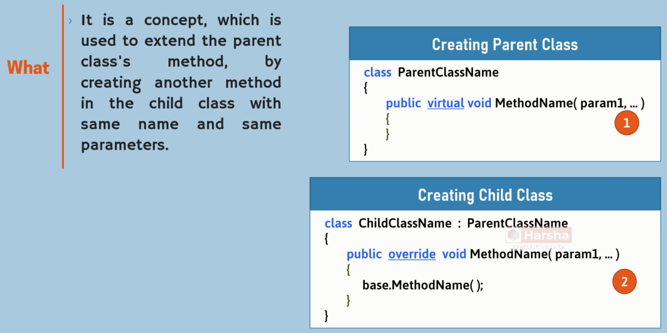
OOP – creating a class – inheritance- overriding

Slide 20
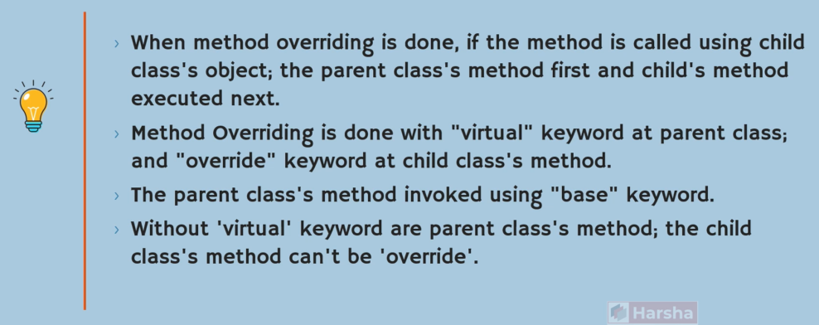
OOP – creating a class – inheritance- overriding

Slide 21
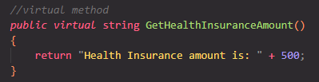
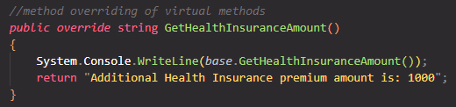
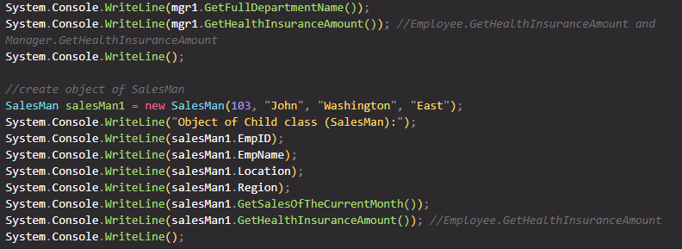
OOP – creating a class – inheritance- overriding

Slide 22
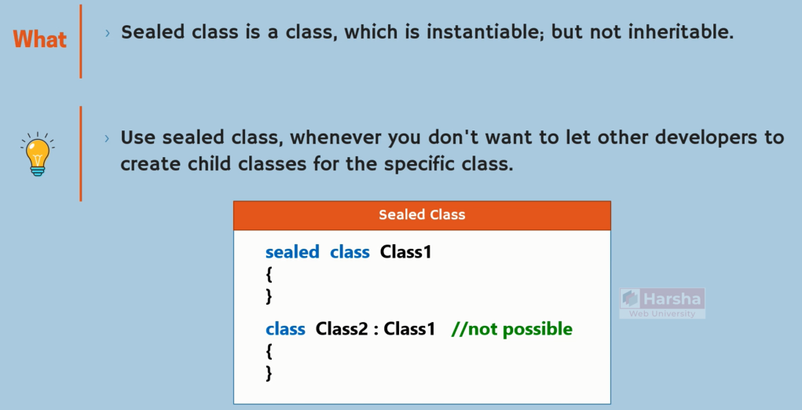
OOP – creating a class – inheritance - sealed

Slide 23
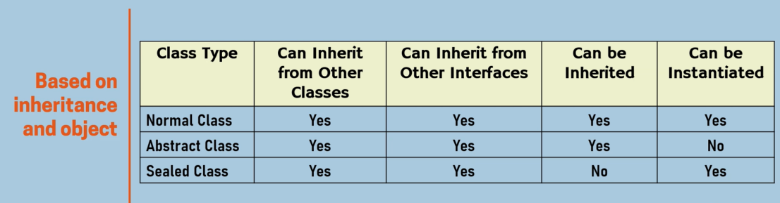
OOP – creating a class – inheritance - sealed

Slide 24
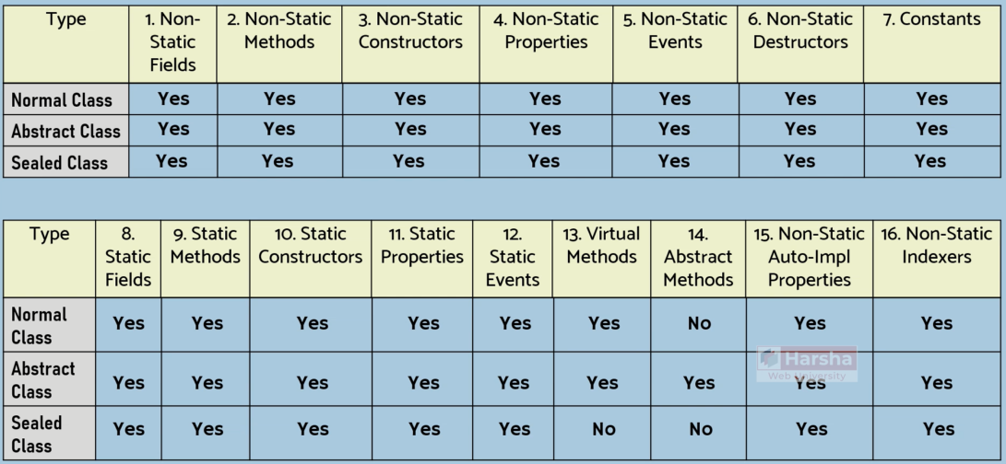
OOP – creating a class – inheritance - sealed

Slide 25
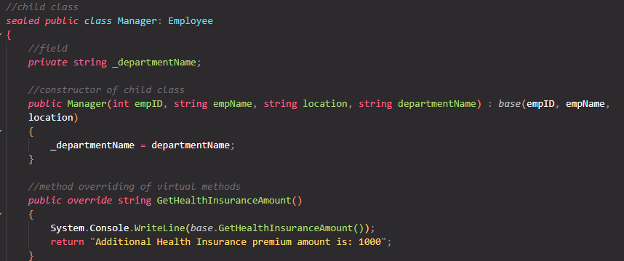
OOP – creating a class – inheritance - sealed

Slide 26
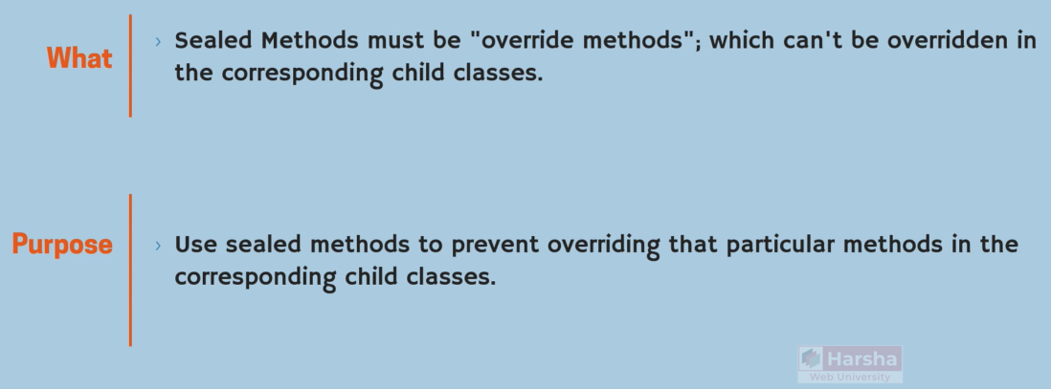
OOP – creating a class – inheritance - sealed

Slide 27
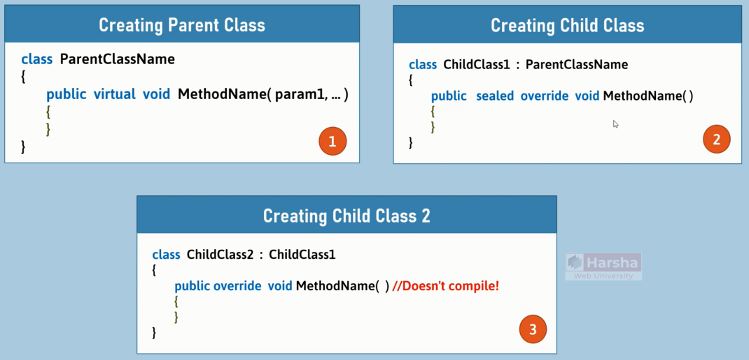
OOP – creating a class – inheritance - sealed

Slide 28
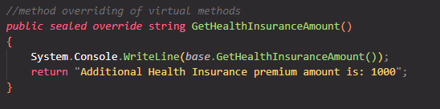
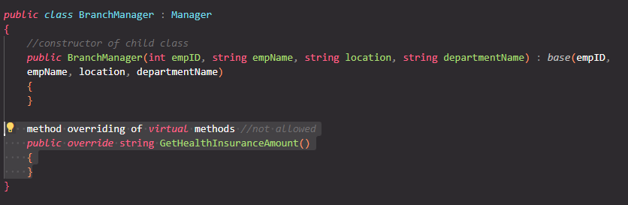
OOP – creating a class – inheritance - sealed

Slide 29
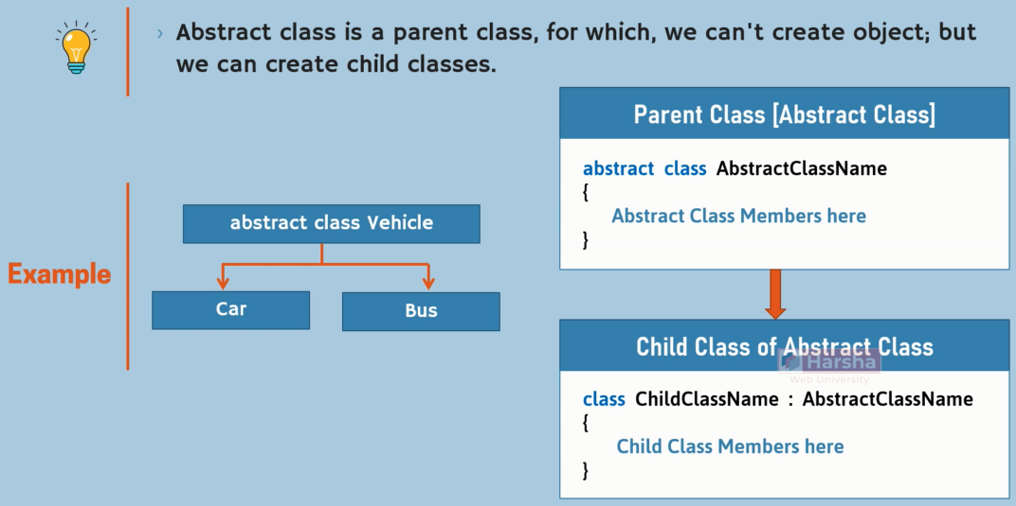
OOP – creating a class – abstract

Slide 30
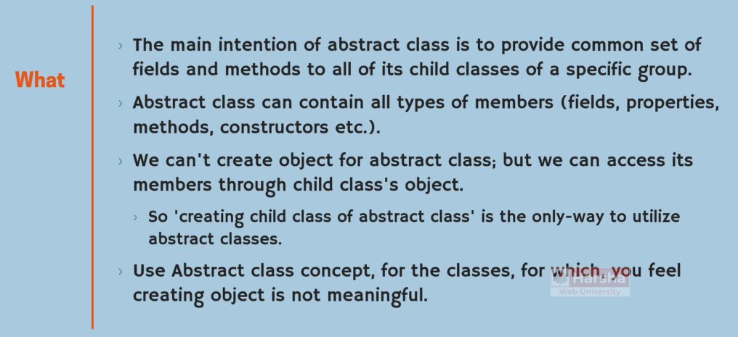
OOP – creating a class – abstract

Slide 31
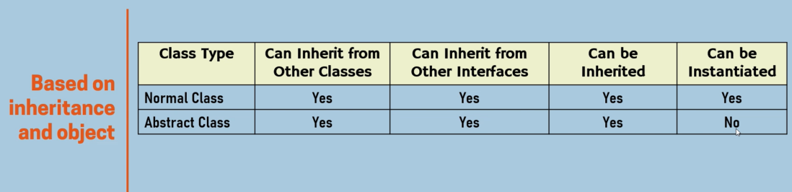
OOP – creating a class – abstract

Slide 32
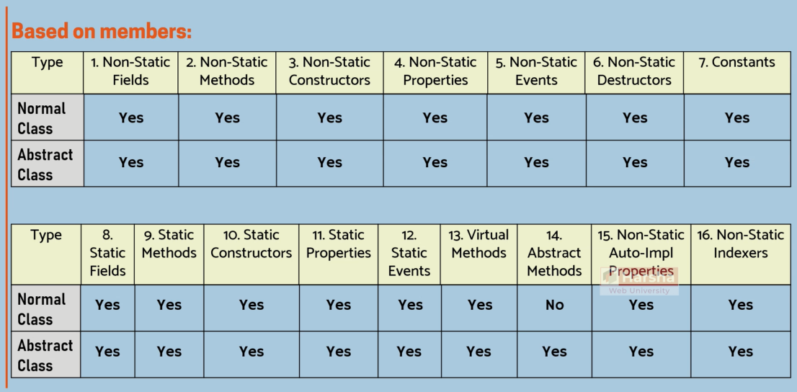
OOP – creating a class – abstract
Notes:
Employee -→ abstract

Slide 33
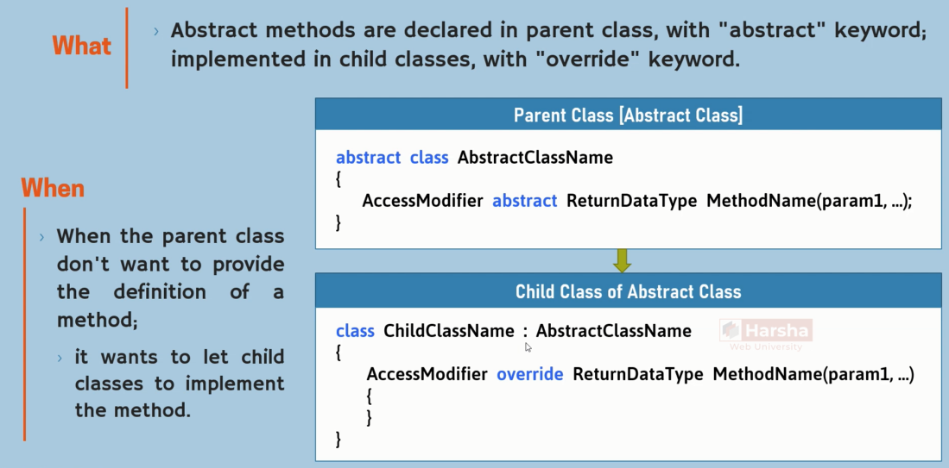
OOP – creating a class – abstract - method

Slide 34

OOP – creating a class – abstract - method

Slide 35

OOP – creating a class – abstract - method

Slide 36


OOP – creating a class – abstract - method

Slide 37

OOP – creating a class – interface

Slide 38

OOP – creating a class – interface

Slide 39


OOP – creating a class – interface

Slide 40


OOP – creating a class – interface

Slide 41


OOP – creating a class – interface

Slide 42

OOP – creating a class – interface

Slide 43

OOP – creating a class – interface

Slide 44


OOP – creating a class – interface

Slide 45


OOP – creating a class – interface

Slide 46


OOP – creating a class – interface

Slide 47


OOP – creating a class – interface

Slide 48

OOP – creating a class – interface- polymorphism

Slide 49


OOP – creating a class – interface- polymorphism

Slide 50


OOP – creating a class – interface- polymorphism

Slide 51


OOP – creating a class – interface- polymorphism

Slide 52

OOP – creating a class – interface- polymorphism

Slide 53

OOP – creating a class – interface- polymorphism

Slide 54

OOP – creating a class – interface- polymorphism

Slide 55

OOP – creating a class – interface- polymorphism

Slide 56

OOP – creating a class – interface- polymorphism

Slide 57

OOP – creating a class – interface - multiple inheritance

Slide 58

OOP – creating a class – interface - multiple inheritance

Slide 59

OOP – creating a class – interface - multiple inheritance

Slide 60





OOP – creating a class – interface - multiple inheritance

Slide 61

OOP – creating a class – interface-inheritance

Slide 62

OOP – creating a class – interface-inheritance

Slide 63

OOP – creating a class – interface

Slide 64

OOP – creating a class – interface

Slide 65

OOP – creating a class – interface

Slide 66

OOP – creating a class – interface vs abstract class

Slide 67

OOP – creating a class – interface vs abstract class

Slide 68

OOP – creating a class – interface vs abstract class

Slide 69

OOP – creating a class – SOLID –Single responsibility

Slide 70

OOP – creating a class – SOLID –Single responsibility

Slide 71

OOP – creating a class – SOLID –Single responsibility

Slide 72

OOP – creating a class – namespaces

Slide 73

OOP – creating a class – namespaces

Slide 74


OOP – creating a class – namespaces

Slide 75

OOP – creating a class – namespaces

Slide 76


OOP – creating a class – namespaces

Slide 77

OOP – creating a class – namespaces-nested

Slide 78

OOP – creating a class – namespaces-nested

Slide 79

OOP – creating a class – namespaces-importing

Slide 80

OOP – creating a class – namespaces-importing

Slide 81

OOP – creating a class – namespaces-alias

Slide 82


OOP – creating a class – namespaces-alias

Slide 83

OOP – creating a class – namespaces-static

Slide 84

OOP – creating a class – namespaces-static

Slide 85

OOP – creating a class – partial classes

Slide 86

OOP – creating a class – partial classes

Slide 87

OOP – creating a class – partial classes

Slide 88





OOP – creating a class – partial classes

Slide 89

OOP – creating a class – partial methods

Slide 90

OOP – creating a class – partial methods

Slide 91

OOP – creating a class – partial methods

Slide 92




OOP – creating a class – partial methods

Slide 93

OOP – creating a class – static classes

Slide 94

OOP – creating a class – static classes

Slide 95

OOP – creating a class – static classes

Slide 96

OOP – creating a class – static classes
Yes

Slide 97


OOP – creating a class – static classes

Slide 98

OOP – creating a class – Enumerations

Slide 99

OOP – creating a class – Enumerations

Slide 100


OOP – creating a class – Enumerations

Slide 101
OOP – creating a class – Enumerations

